Slide 1
Master Thesis
Images for Thesis and presentation

Slide 2

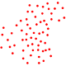
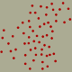
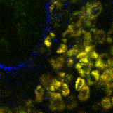
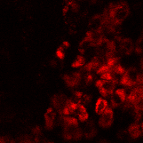
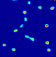
Napari
Point cloud
Labeling with points in 3D
Training data
Density maps for multiple cell classes
U-net
Stack
NADH
Cell Number
Threshold + Object counting

Slide 3


Simulator
Stack
Data
Napari
FIJI
or
Annotation
PointCloud.csv
PointCloud.roi
PointCloud
FAD Synthetic
PointCloud
FAD
Training data
MBT-net
MBT-net

Slide 4
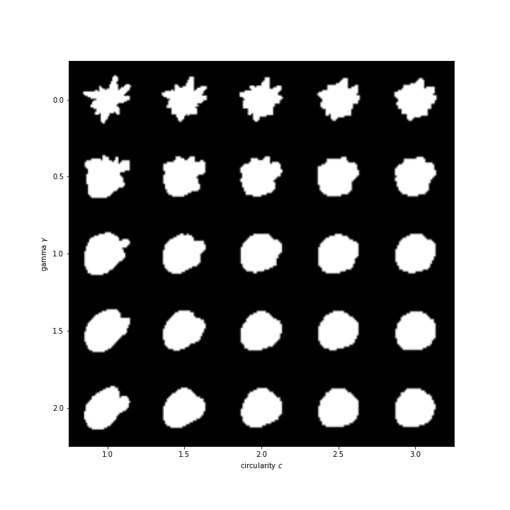
Shape generation with differrent parameters

Slide 5
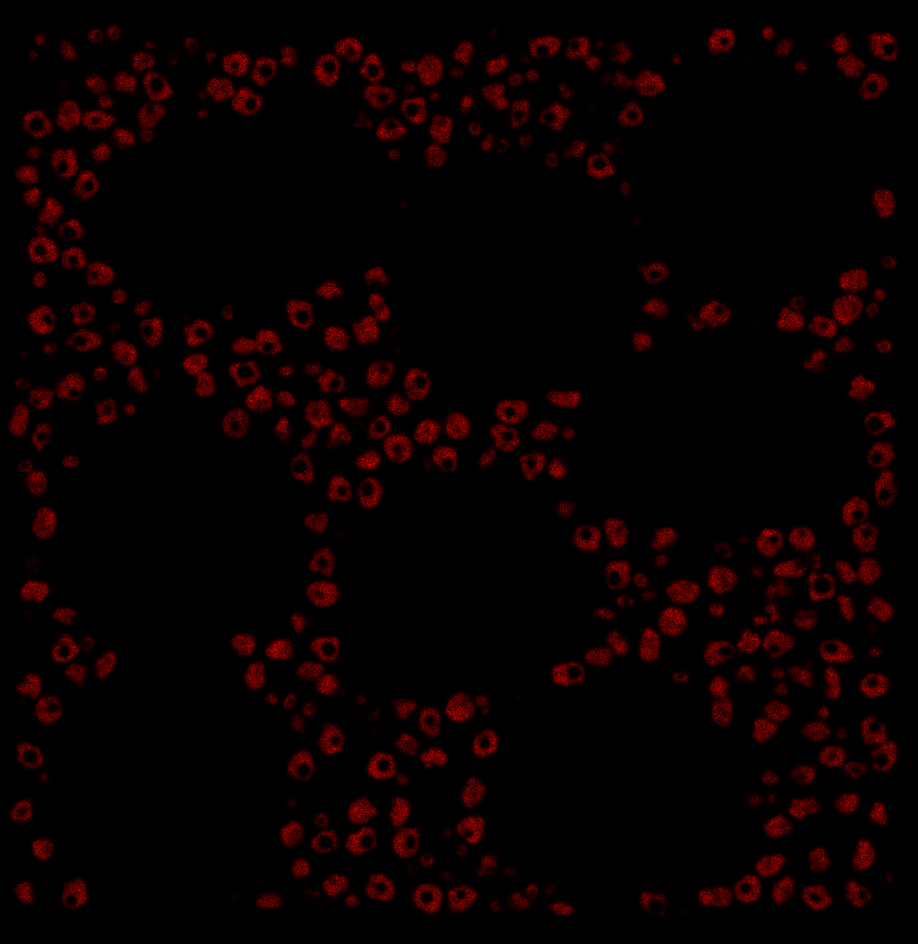
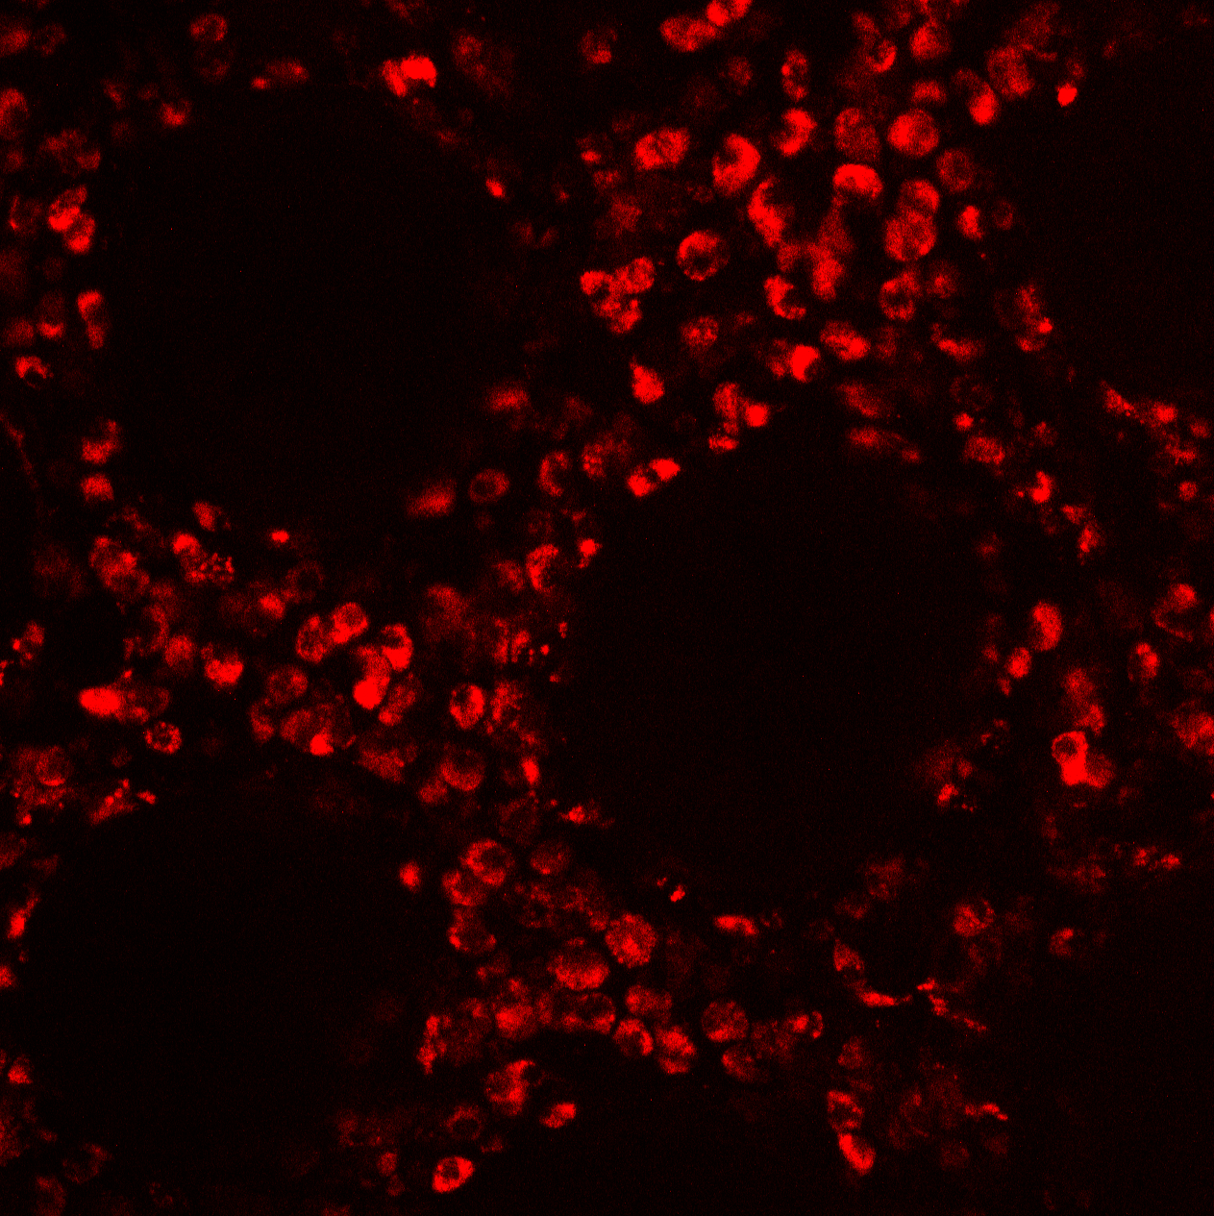
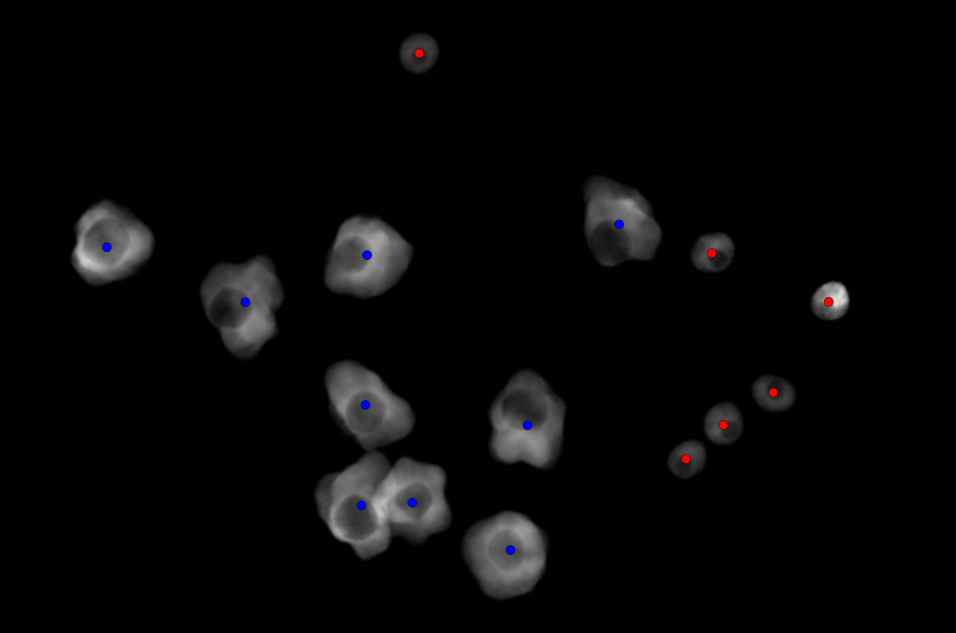
Simulated
Real
Simulated volume view
Macrophage
T-cell
Guess where is the simulated image?

Slide 6
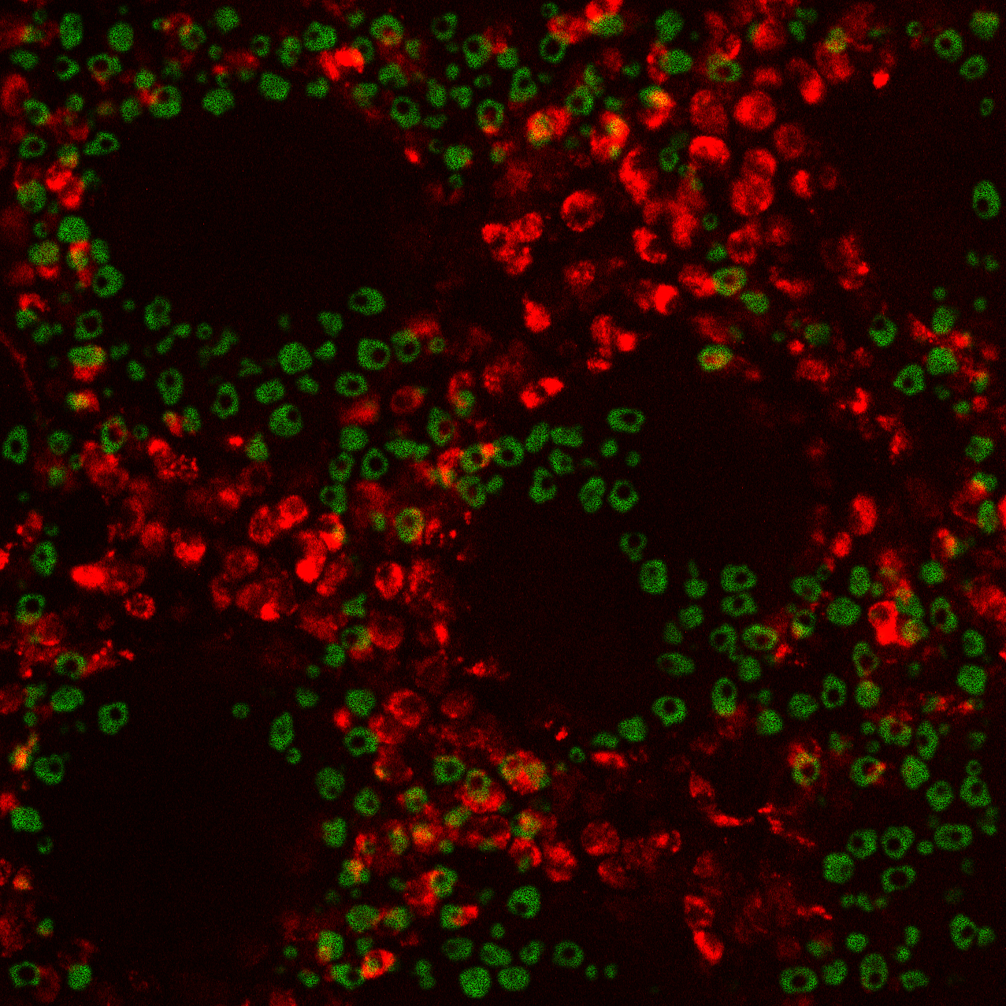

Slide 7
w₁₁
a₁
x₁
w₁₂
a₂
w₁₃
x₂
y₁
w₁₄
a₃
x₃
a₄

Slide 8
a₁
x₁
w₂₁
w₂₂
a₂
x₂
y₁
w₂₃
a₃
w₂₄
x₃
a₄

Slide 9
B.
A.
w₁₁
a₁
a₁
w₂₁
x₁
x₁
w₁₂
w₂₂
a₂
a₂
x₂
w₁₃
y₁
x₂
y₁
w₂₃
a₃
a₃
w₁₄
w₂₄
x₃
x₃
a₄
a₄
C.
A
X
a₁
x₁
a₂
Y
x₂
y₁
a₃
x₃
a₄

Slide 10
a₁
x₁
a₂
x₂
y₁
a₃
x₃
a₄

Slide 11
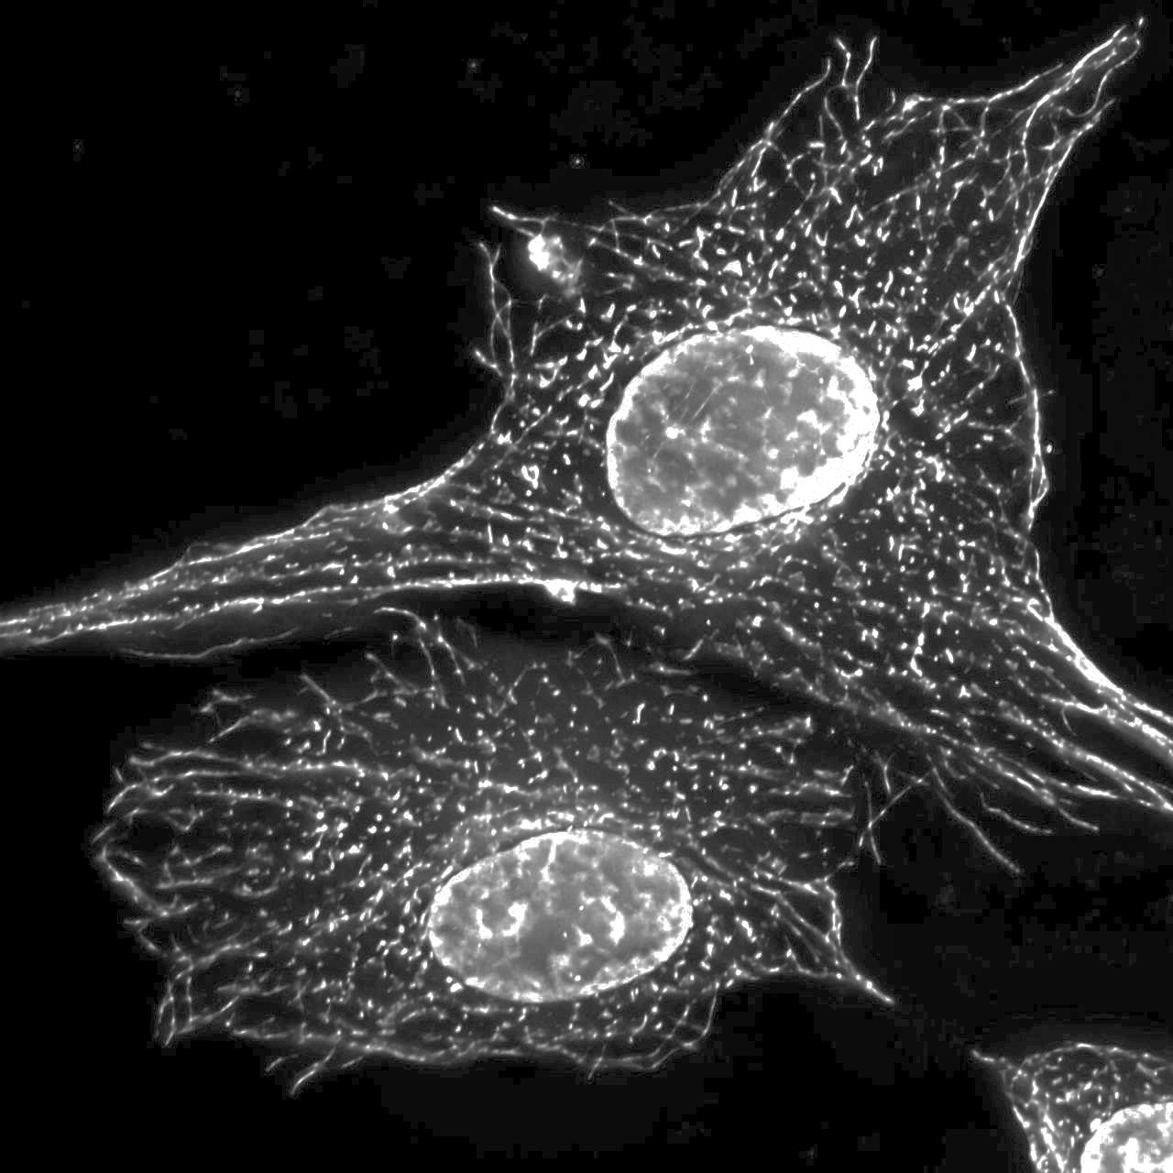
k₁
k₁
k₂
…
k₃
k₂
k₃
k₄

Slide 12
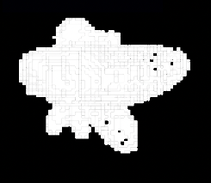
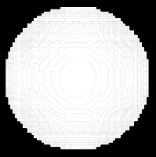
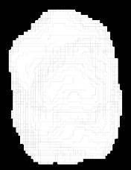
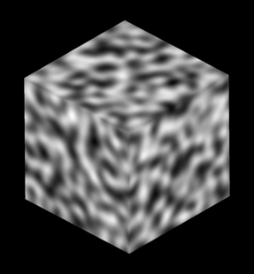
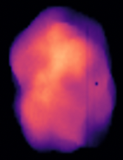
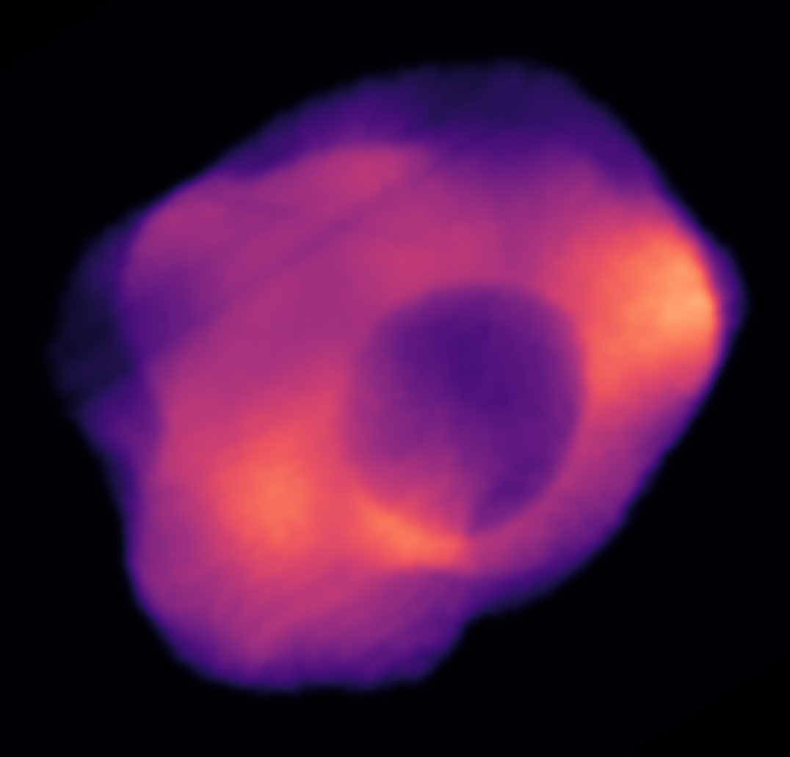
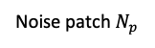
Noise patch $N_{p}$
Resulted blob
shape mask
Noise space
Blob
Sphere
+
=
+
=
Sampling from
noise space
Generate 2 blobs for cell and for nucleus
-
=
Nucleus mask
Noise space
Cell body
Simulated Cell

Slide 13
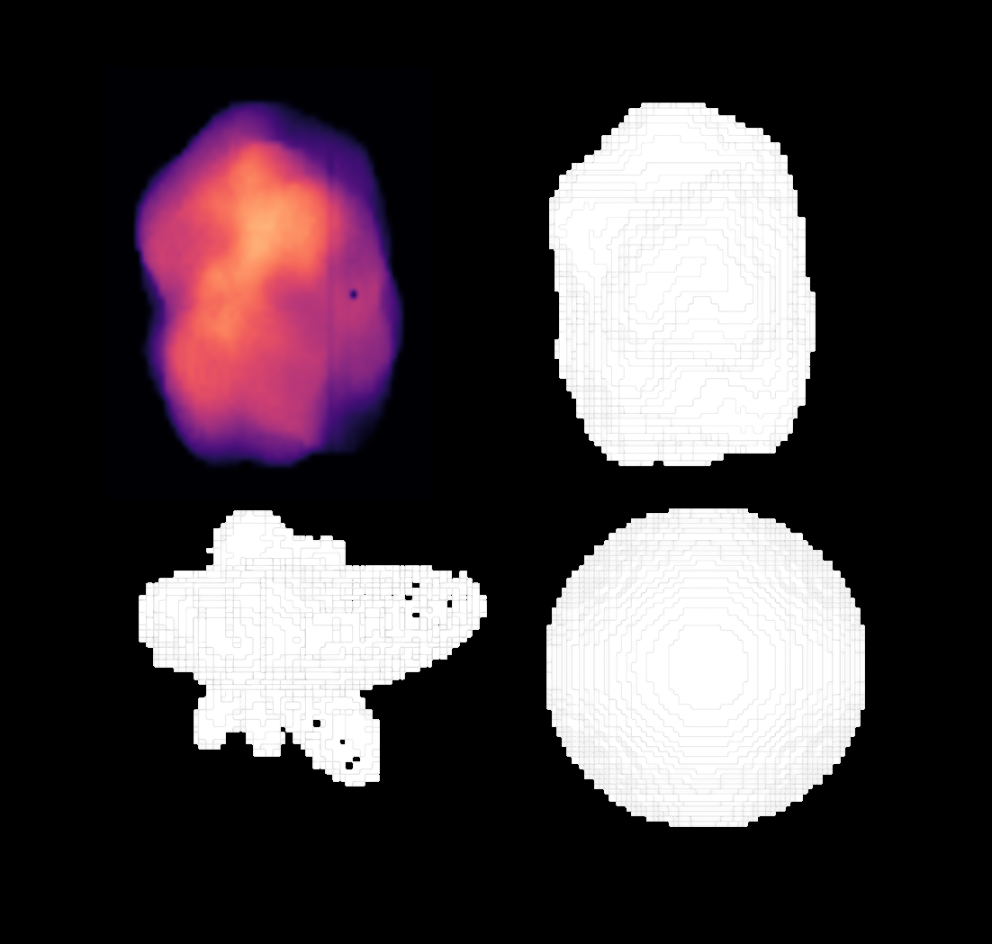

Slide 14
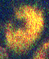
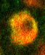
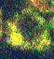
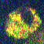
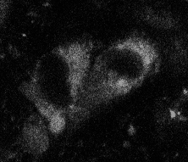
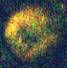
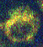
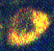
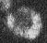
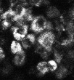
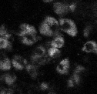

Slide 15

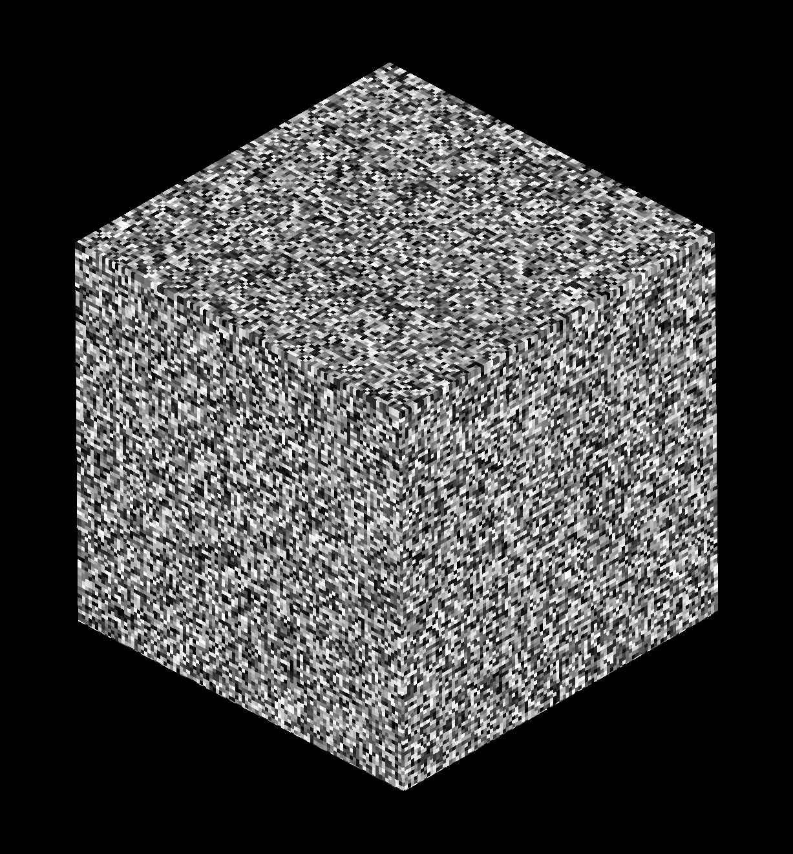
Opensimplex
Random

Slide 16
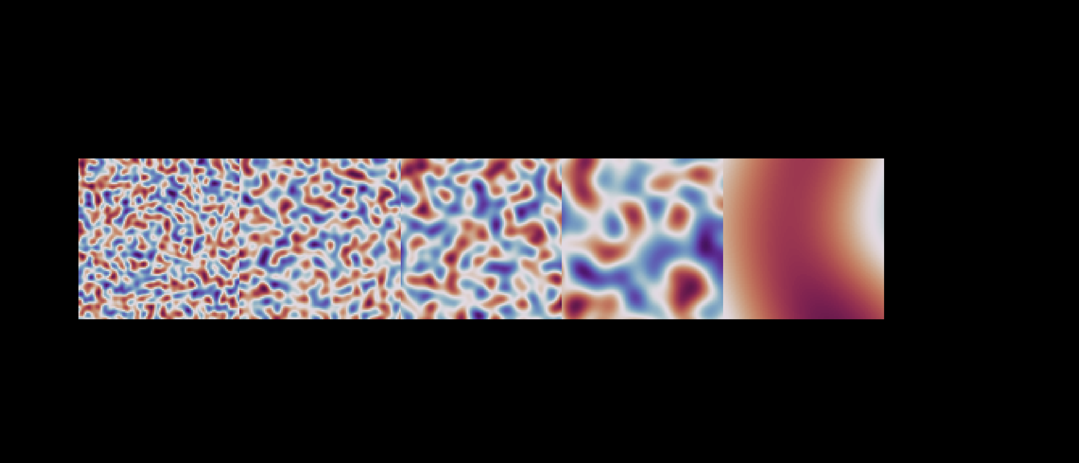

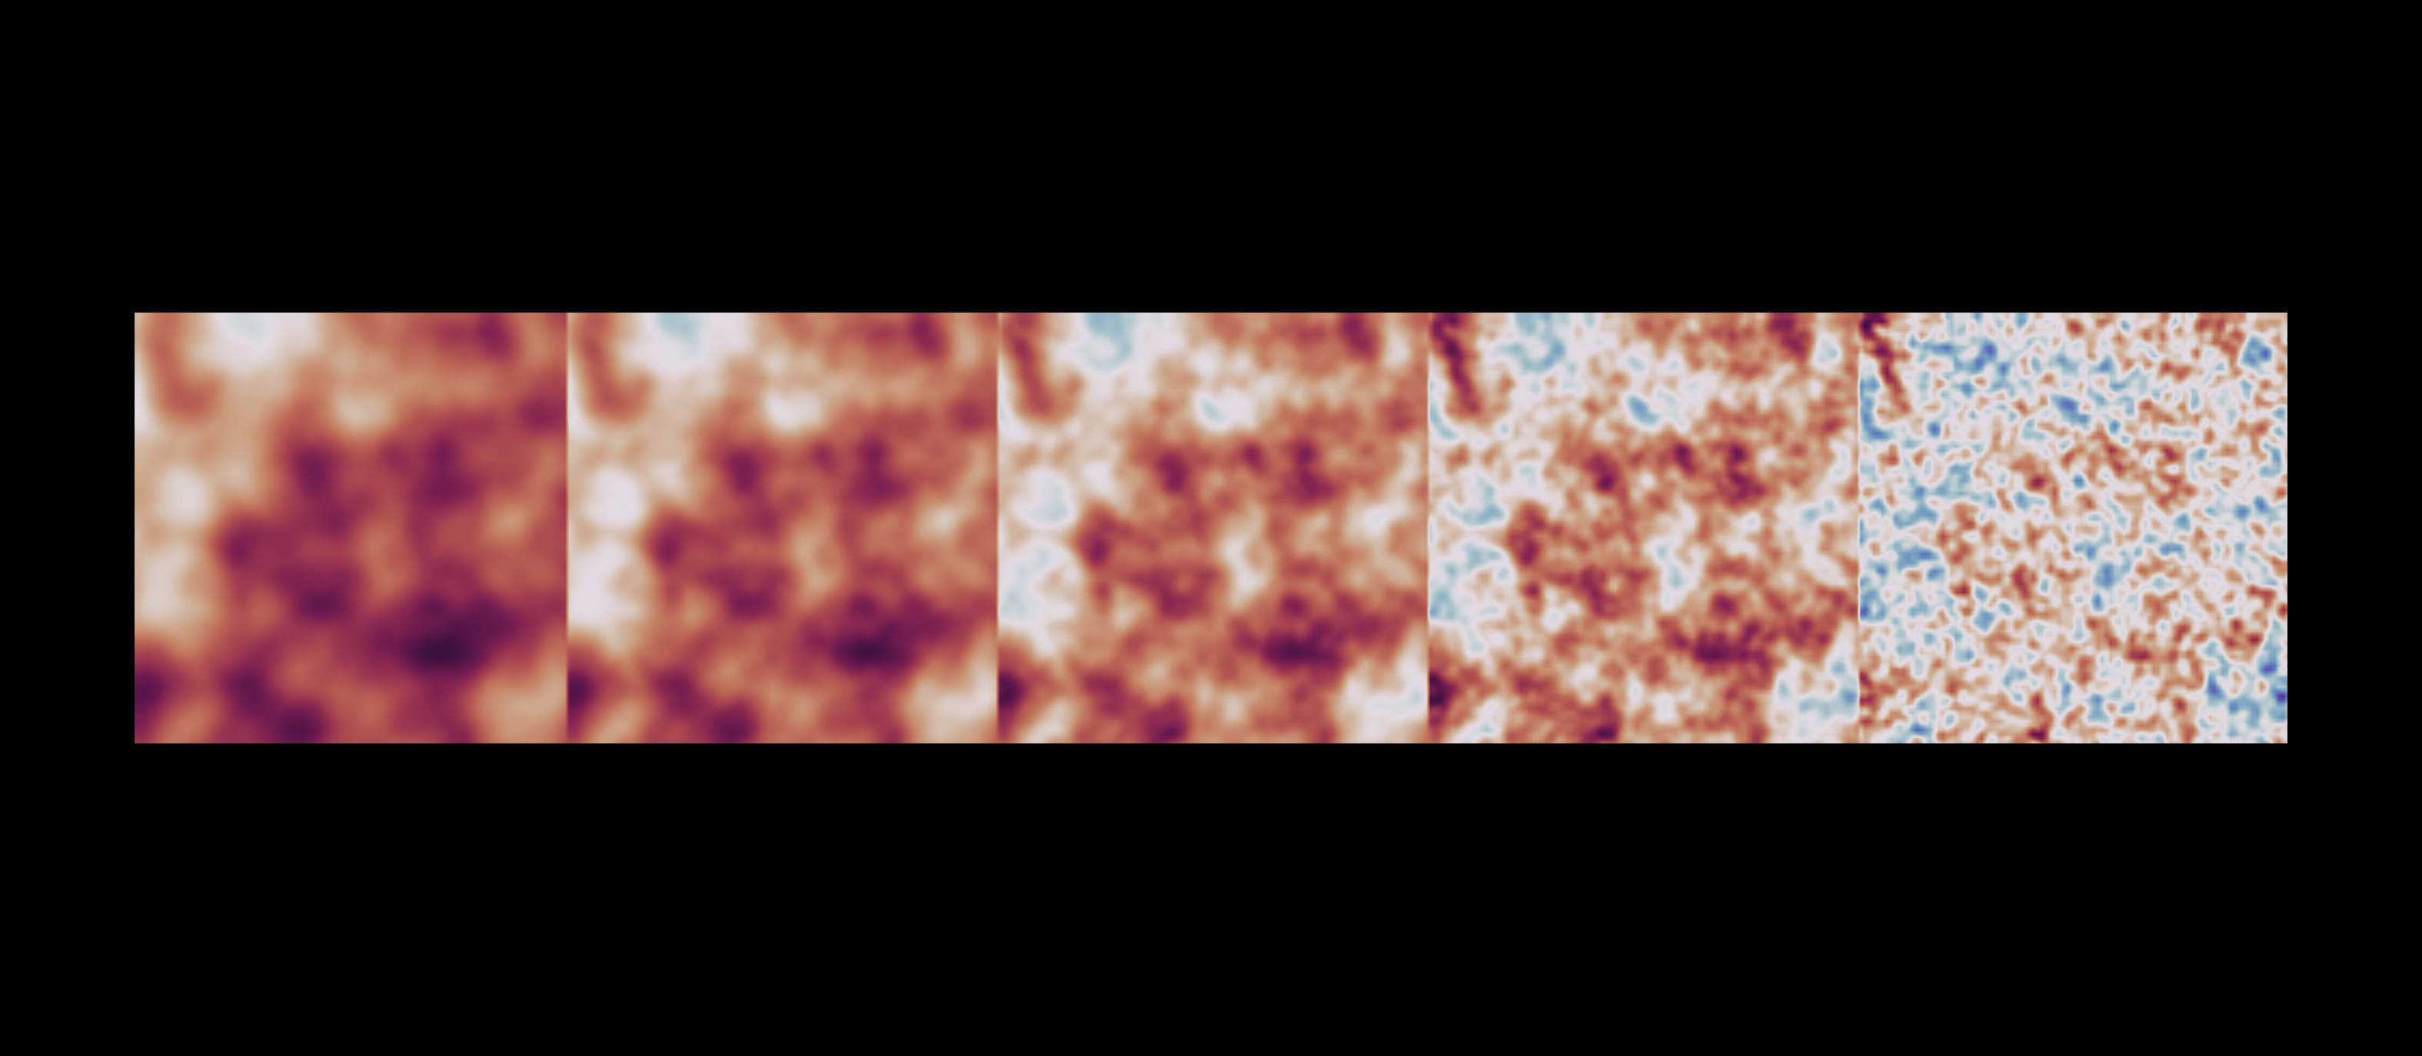
A.
∑
=
⍺
B.
0.0
0.25
0.5
0.75
1.0
𝛾

Slide 17
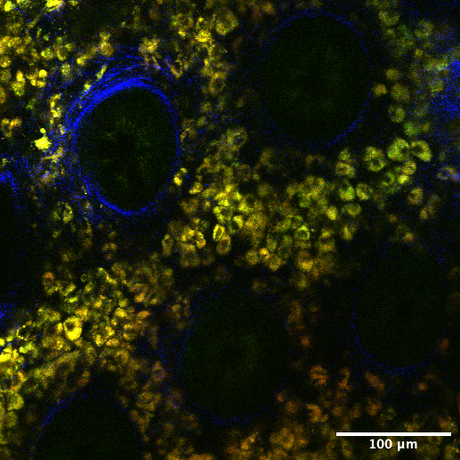
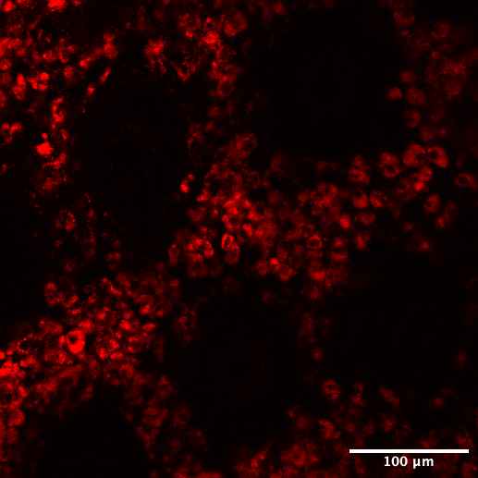
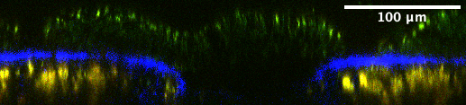
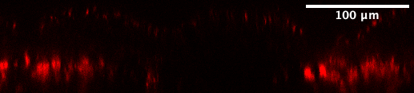
RGB (FAD, NADH, SHG)
R (FAD)
Crypt
Crypt
Crypt
Crypt
Top view
Crypt
Crypt
Crypt
Crypt
Side view
Crypt
Crypt

Slide 18
summation
concatenation
Linknet
U-net

Slide 19
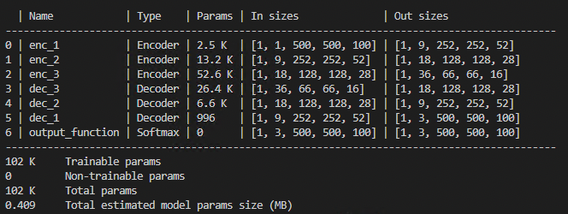
+
+
+
18 x 128 x 128 x 28
36 x 66 x 66 x 16
18 x 128 x 128 x 28
9 x 252 x 252 x 52
MBT-net
9 x 252 x 252 x 52
1 x 500 x 500 x 100
3 x 500 x 500 x 100
Encoder block
Decoder block
BatchNorm
Conv3D
LeakyReLU
Conv3D
LeakyReLU
MaxPool
Interpolation
BatchNorm
Conv3D
LeakyReLU
Conv3D
LeakyReLU

Slide 20
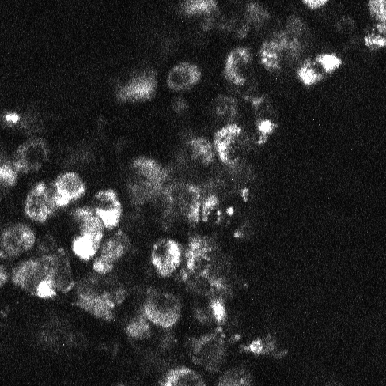

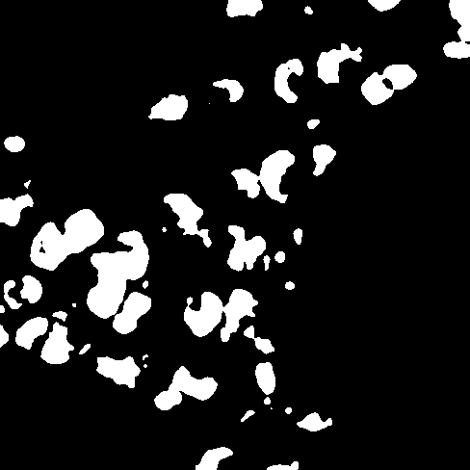


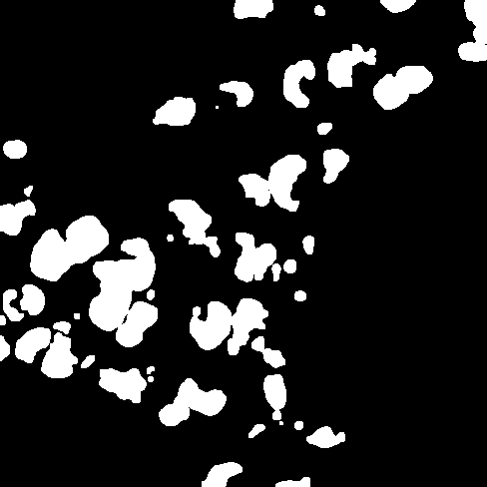

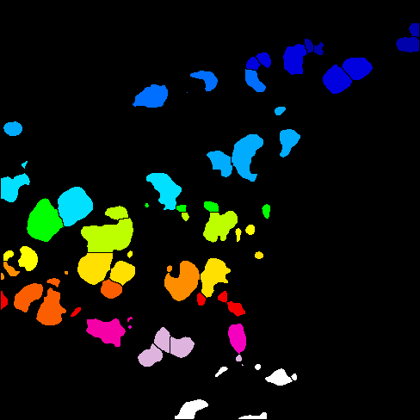
0.Raw
1.Blur
2.Threshold
3.Fill holes
4.Erode
5.Dilate
6.Watershed
7.Label

